Slide 1


Mid Term Continuous Assessment
(Semester VI)
Vivekanand Education Society's Institute of Technology
An Autonomous Institute Affiliated to University of Mumbai
To make a memory game using Image processing.
Name of Guide : Mr. Mrugendra Vasmatkar
GroupNo.:10
1 Anshkumar Agrahari – 01 (D14B)
2 Pranav Jha – 24 (D14B)
3 Ashish Nair – 37 (D14B)
4 Akash Neharkar – 40 (D14B)

Slide 2
Contents
Problem Statement
Proposed Solution
Complete Block Diagram of Proposed System
Methodology
Observations/Results
Conclusion
References

Slide 3
Problem Statement
To make a memory game using Image processing.

Slide 4
Proposed Solution
This project explores the integration of image processing techniques in solving jigsaw puzzles, aiming to understand the cognitive and computational processes involved. Key areas of focus include image segmentation, feature extraction, matching algorithms, and performance evaluation.

Slide 5
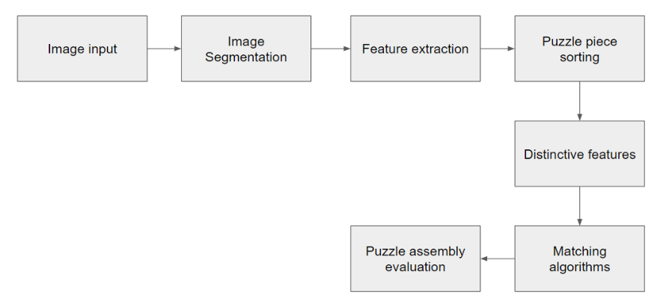
Block Diagram
Fig.1 Block Diagram of the game.

Slide 6
Methodology
Project Planning and Requirements Gathering:
1.Define the project scope, objectives, and target audience.
2.Identify the core features of the game, such as image splitting, puzzle shuffling, user input handling, and level progression.
3.Gather requirements regarding game mechanics, user interface elements, and visual assets.
Environment Setup:
1.Install the necessary development tools and libraries, including Python and Pygame.
2.Set up the project directory structure and version control system if applicable.

Slide 7
Methodology
Image Selection and Preparation:
1.Choose a variety of images suitable for use in the jigsaw puzzle game.
2.Ensure that selected images are appropriately sized and formatted for display within the game window.
3.Optionally, preprocess images to improve clarity, adjust colors, or apply effects.
Code Architecture and Design:
Design the overall architecture of the game, including class structures, function definitions, and module organization.
Define the key components of the game, such as the Button class, functions for image manipulation, and game loop logic.
Plan the user interface layout, including the arrangement of buttons, image display areas, and other interactive elements.

Slide 8
Methodology
Implementation:
Develop the game components according to the defined architecture and design.
Begin by implementing basic functionalities, such as loading and displaying images, handling user input, and rendering graphics.
Iteratively add more features, starting with image splitting and puzzle shuffling, followed by level progression, solution checking, and visual feedback mechanisms.
Test each component thoroughly to ensure functionality, stability, and compatibility across different platforms.

Slide 9
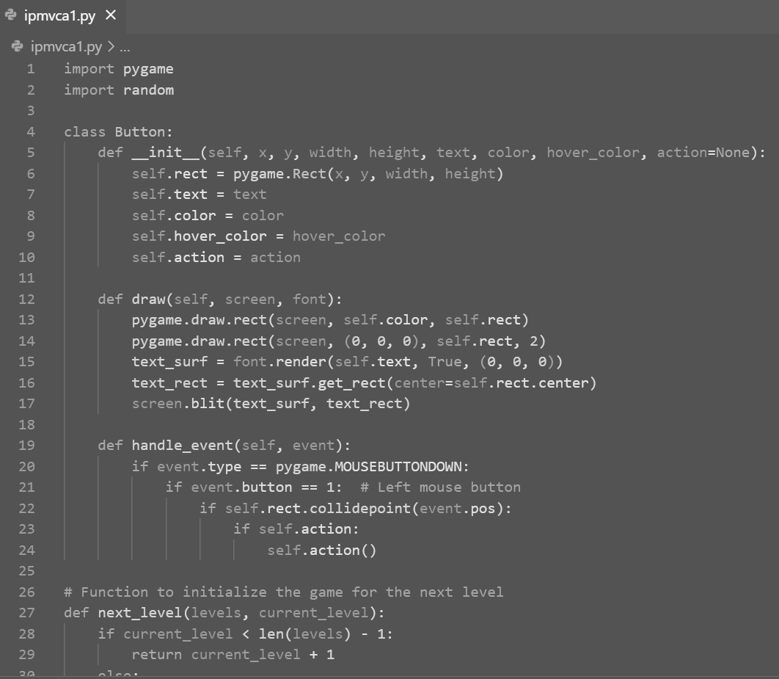
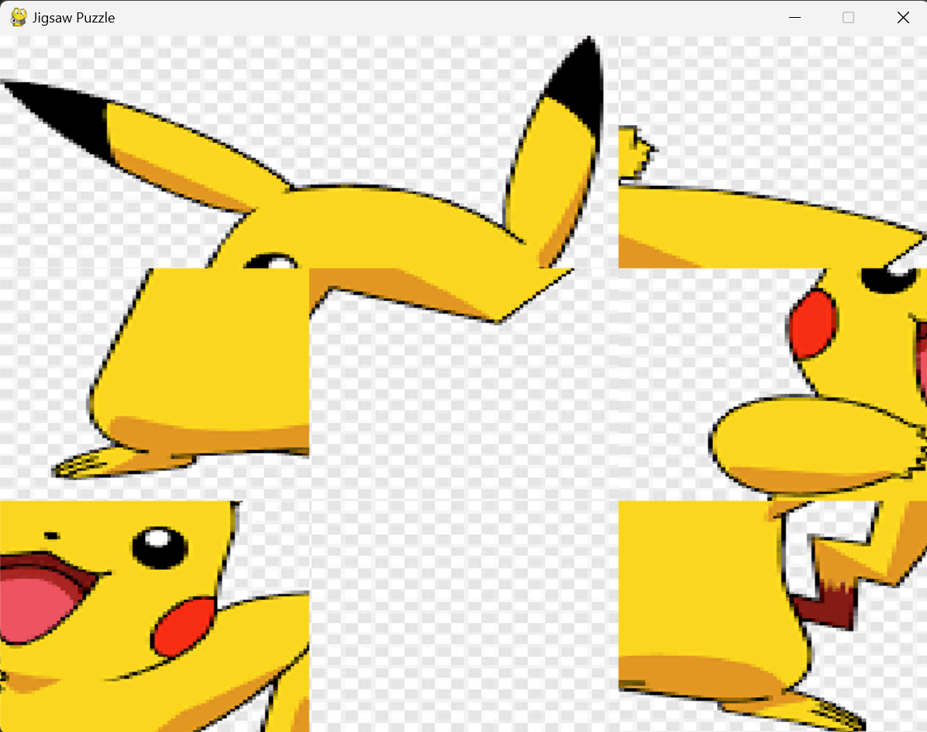
Implementation
Fig 2.Python Code
Fig 3.GUI Output

Slide 10
Observations / Results
Modular Design: The code exhibits a modular design, with functionalities encapsulated within functions and a Button class. This design promotes code organization, readability, and reusability.
Pygame Integration: The use of Pygame library facilitates the creation of interactive graphical user interfaces (GUIs) and game loops. Pygame's features enable the handling of events, rendering of graphics, and management of game states effectively.
Game Logic: The code effectively implements the logic for a jigsaw puzzle game. It includes functions for splitting images into pieces, shuffling them, checking for solutions, and managing level transitions. These functionalities contribute to the core gameplay experience.
User Interaction: The code provides a user-friendly interface with buttons for initiating actions such as transitioning to the next level. The handling of mouse events allows players to interact with puzzle pieces intuitively, enhancing the overall user experience.
Level Progression: The game progresses through multiple levels, each presenting a new image and puzzle grid size. This level-based structure adds depth and variety to the gameplay, increasing player engagement and providing a sense of achievement upon completing each level.

Slide 11
Conclusion
In conclusion, the jigsaw puzzle game developed using the Pygame library presents a compelling demonstration of interactive game development in Python. Through the implementation of various functionalities such as image splitting, puzzle shuffling, user input handling, and level progression, the project showcases fundamental principles of game design and programming.
Players can enjoy a seamless gaming experience, navigating through multiple levels and solving puzzles with ease.
Furthermore, the scalability of the game allows for the incorporation of additional levels, images, and features, offering potential for further development and customization.

